Slide 1
Annual Action Plan
1st Jan to 31st Dec-20-----
Date, 202--
KVK, Name
Annual Action Plan Workshop of KVK’s
Presented by
Head Name
Senior Scientist & Head

Slide 2
MAP KVK Jurisdiction
Demographic Information
Taluka | Area (Km²) | No. of Villages
Total
Rainfall
Month | Rainfall (mm) | Rainy Days
Total

Slide 3
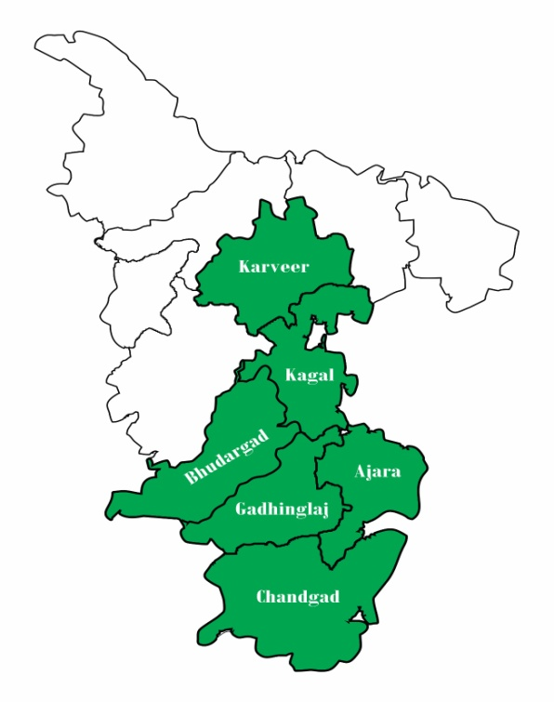
PRA Survey of Adopted Villages
Total Area
Total Cultivated Area
Average Landholding
Major Crops
Total Area
Total Cultivated Area
Average Landholding
Major Crops
Total Area
Total Cultivated Area
Average Landholding
Major Crops
Total Area
Total Cultivated Area
Average Landholding
Major Crops
Total Area
Total Cultivated Area
Average Landholding
Major Crops
Total Area
Total Cultivated Area
Average Landholding
Major Crops

Slide 4
000
TALUKAS
Major Crops
and Enterprises
Cropping Systems
Major Farming Systems
Name of Crops
Name of Cropping System
Technical Staff
Name
Designation

Slide 5
New Initiatives / Highlights of Action Plan

Slide 6
District Level Need Assessment and Planning of Activities for 202--
Major crops & enterprises | Major problem identified | Identified Thrust Areas
Agronomy
Soil Science
Plant Protection

Slide 7
District Level Need Assessment and Planning of Activities for 202--
Major crops & enterprises | Major problem identified | Identified Thrust Areas
Animal Science
Home Science
Agricultural Extension

Slide 8
Summary of Action Plan 202--
S. No | Activity | No. of Programmes | No. of Participants
 |  |  | Male | Female | Total
1 | On Farm Trials
2 | Front Line Demonstration
3 | Cluster Front Line Demonstrations (O & P)
4 | Training Programmes
4.1 | Farmers / Farm Women
4.2 | Rural Youth
4.3 | Extension Functionaries
5 | Extension Activities (Major)
6 | Total

Slide 9
Action Plan 202--
Name | Designation & Discipline | OFT | FLD | Farmer Training | In-service training
 | SMS (Agronomy)
 | SMS (Soil Science)
 | SMS (Plant Protection)
 | SMS (Home Science)
 | SMS (Agril. Extension)
 | SMS (Animal Science)
Total

Slide 10
I. Assessment (Continue): ---- Year (Discipline)
Title of OFT
Problem Identified
Objectives
Micro-farming Situation
Treatments | Farmers Practice (T1):
 | Assessed Practice (T2):
 | Assessed Practice (T3):
Year of Start
Area (ha)
No. of Trials
Source of Technology
Critical Inputs to be used and its Cost in Rs.
Observations to be recorded

Slide 11
II. Assessment (Continue): --- Year (Discipline)
Title of OFT
Problem Identified
Objectives
Micro-farming Situation
Year of Start
Treatments | Farmers Practice (T1):
 | Assessed Practice (T2):
 | Assessed Practice (T3):
Area (ha)
No. of Trials
Source of Technology
Critical Inputs to be used and its Cost in Rs.
Observations to be recorded

Slide 12
III. Assessment (Continue): -- Year (Discipline)
Title of OFT
Problem Identified
Objectives
Micro-farming Situation
Treatments | Farmers Practice (T1):
 | Assessed Practice (T2):
Area (ha)
No. of Trials
Source of Technology
Critical Inputs to be used and its cost in Rs.
Observations to be recorded

Slide 13
IV. Assessment (Continue): --- Year (Discipline)
Title of OFT
Problem Identified
Objectives
Micro-farming Situation
Treatments | Farmers Practice (T1):
 | Assessed Practice (T2):
Area (ha)
No. of Trials
Source of Technology
Critical Inputs to be used and its cost in Rs.
Observations to be recorded

Slide 14
V. Assessment (Continue): --- Year (Discipline)
Title of OFT
Problem Identified
Objectives
Micro-farming Situation
Treatments | Farmers Practice (T1):
 | Assessed Practice (T2):
 | Assessed Practice (T3):
Area (ha)
No. of Trials
Source of Technology
Critical Inputs to be used and its cost in Rs.
Observations to be recorded

Slide 15
VI . Assessment (Continue): --- Year (Discipline)
Title of OFT
Problem Identified
Objectives
Micro-farming Situation
Treatments | Farmers Practice (T1):
 | Assessed Practice (T2):
Area (ha)
No. of Trials
Source of Technology
Critical Inputs to be used and its cost in Rs.
Observations to be recorded

Slide 16
VII. Assessment (New): --- Year (Discipline)
Title of OFT
Problem Identified
Objectives
Micro-farming Situation
Treatments | Farmers Practice (T1):
 | Assessed Practice (T2):
Area (ha)
No. of Trials
Source of Technology
Critical Inputs to be used and its cost in Rs.
Observations to be recorded

Slide 17
VIII. Assessment (New): -- Year (Discipline)
Title of OFT
Problem Identified
Objectives
Micro-farming Situation
Treatments | Farmers Practice (T1):
 | Assessed Practice (T2):
No. of Trials
Source of Technology
Critical Inputs to be used and its cost in Rs.
Observations to be recorded

Slide 18
IX. Assessment (New): -- Year (Discipline)
Title of OFT
Problem Identified
Objectives
Micro-farming Situation
Treatments | Farmers Practice (T1):
 | Assessed Practice (T2):
No. of Trials
Source of Technology
Critical Inputs to be used and its cost in Rs.
Observations to be recorded

Slide 19
X. Assessment (Continue): -- year (Discipline)
Title of OFT | Assessment of Improved Groundnut stripper for stripping groundnut pods
Problem Identified
Objectives
Treatments | Farmers Practice (T1):
 | Assessed Practice (T2):
No. of Trials
Source of Technology
Critical Inputs to be used and its cost in Rs.
Observations to be recorded

Slide 20
XI. Assessment (Continue): --- year (Discipline)
Title of OFT | Assessment of solar operated nipping (green foliage collector) machine for chickpea
Problem Identified
Objectives
Treatments | Farmers Practice (T1):
 | Assessed Practice (T2):
No. of Trials
Source of Technology
Critical Inputs to be used and its cost in Rs.
Observations to be recorded

Slide 21
Action Plan for Front Line Demonstrations (Other than CFLD)
Crop | Season | Purpose of demonstration | Farming situation | Variety | Area (ha) | No. of demos | Critical Inputs Identified | Cost (Rs) | Parameters of observation

Slide 22
Action Plan for Front Line Demonstrations (Other than CFLD)
Crop | Season | Purpose of demonstration | Farming situation | Variety | Area (ha) | No. of demos | Critical Inputs Identified | Cost (Rs) | Parameters of observation

Slide 23
Action Plan for Cluster Front Line Demonstrations (Oilseed)
Crop | Season | Purpose of demonstration | Farming situation | Variety | Area (ha) | No. of demos | Critical Inputs Identified | Cost (Rs) | Parameters of observation

Slide 24
Front Line Demonstrations (Regarding Livestock and Fisheries)
Name of animal | Name of breed | Purpose of demonstration | Month of implement | No. of demos (Units) | No. of animals to be covered per unit | Critical Inputs Identified | Cost of critical inputs (Rs) | Parameters of observation
Cattle
Buffalo
Other (Cattle, Buffalo, Sheep & Goat, poultry)

Slide 25
Front Line Demonstrations (Regarding Agricultural Implements)
Name of the implement to be demonstrated | Purpose of demonstration | Month | No. of farmers to be covered | Critical Inputs Identified | Cost (Rs) | Parameters of observation
Front Line Demonstrations (Regarding other enterprises)
Name of the Enterprise | Purpose of demonstration | Month of implementation | No. of demonstrations | No. of farmers | Critical Inputs Identified | Cost (Rs) | Parameters of observation

Slide 26
Action Plan for Training Programmes
A. Practicing Farmers (PF)
S. No. | Date | Title of training | Venue (On/Off/Online) | Duration (Days) | No. of participants
 |  |  |  |  | Male | Female | Total
1 |  | Integrated crop management in paddy
2 |  | Integrated crop management in soybean
3 |  | Groundnut Production technology
4 |  | Improved crop management technologies in finger millet
5 |  | Integrated farming system
6 |  | Improved crop management technologies in rabi sorghum
7 |  | Integrated Crop Management in Gram
8 |  | Super cane nursery Management
9 |  | Organic farming
10 |  | Sugarcane trash management
11 |  | Integrated crop management in sugarcane
12 |  | Ratoon Sugarcane cultivation practices
13 |  | Seed Production technique of soybean crop
Continue…

Slide 27
Action Plan for Training Programmes
A. Practicing Farmers (PF)
S. No. | Date | Title of training | Venue (On/Off/Online) | Duration (Days) | No. of participants
 |  |  |  |  | Male | Female | Total
14 |  | Soil Health Management
15 |  | Sugarcane trash management
16 |  | Production & use of Organic Inputs
17 |  | Importance of Soil & Water Testing
18 |  | Awareness on use of bio-fertilizer
19 |  | INM in Soybean
20 |  | Organic Farming
21 |  | Nutrient Use efficiency
22 |  | INM in pre-seasonal & suru Sugarcane
23 |  | Crop residue recycling to improve soil organic carbon
24 |  | Organic Farming
Continue…

Slide 28
Action Plan for Training Programmes
A. Practicing Farmers (PF)
S. No. | Date | Title of training | Venue (On/Off/Online) | Duration (Days) | No. of participants
 |  |  |  |  | Male | Female | Total
25 |  | Management of FAW in fodder Maize
26 |  | Integrated Disease Management in Okra
27 |  | Bio-Intensive Pest Management with special reference to fall army worm, Spodoptera furgiperda
28 |  | Precautions while selection, purchasing and handling of pesticides
29 |  | Integrated Pests Management in Sugarcane crops
30 |  | Integrated Diseases Management in Soybean
31 |  | Integrated Pests Management in Rice
32 |  | Integrated Pest & Diseases Management in Tomato
33 |  | Integrated Disease Management in Ground nut
Continue…

Slide 29
Action Plan for Training Programmes
A. Practicing Farmers (PF)
S. No. | Date | Title of training | Venue (On/Off/Online) | Duration (Days) | No. of participants
 |  |  |  |  | Male | Female | Total
34 |  | Animal Diseases Management
35 |  | Information about Indian Cow Breeds
36 |  | Nutritional management in Cattle, Buffalo, Sheep & Goat
37 |  | Promotion of fodder & seed production.
38 |  | Care and management of animals during rainy season.
39 |  | Cultivation of hydroponic fodder, Azolla & its importance in animal feed
40 |  | Promotion of Backyard poultry farming
41 |  | Preservation of green fodder by Silage Making & treatment of crop residues
42 |  | Ecto-Endo Parasite Management
43 |  | Clean Milk production
Continue…

Slide 30
Action Plan for Training Programmes
A. Practicing Farmers (PF)
S. No. | Date | Title of training | Venue (On/Off/Online) | Duration (Days) | No. of participants
 |  |  |  |  | Male | Female | Total
44 |  | Low cost & Traditional Nutritious millets recipes
45 |  | Development of Nutritional garden for rural and urban families
46 |  | Development of Millets garden
47 |  | Importance and use of millet for balance diet of preschool child and lactating mother
48 |  | Use of Improved Farm Tools for drudgery reduction of farm women
49 |  | Development of value added products from soybean and its use in diet
50 |  | Programme on minimization of nutrient loss during cooking
51 |  | Equipment's & Machineries for millets processing
52 |  | Agro-based income generating activities for rural women
53 |  | Cooking techniques for millets and its use in diet
54 |  | Development of organic terrace garden
Continue…

Slide 31
Action Plan for Training Programmes
A. Practicing Farmers (PF)
S. No. | Date | Title of training | Venue (On/Off/Online) | Duration (Days) | No. of participants
 |  |  |  |  | Male | Female | Total
55 |  | Formation of Farmer producer company
56 |  | Commodity Based Farming
57 |  | Agro Tourism
58 |  | Agricultural Marketing of organic produce
59 |  | Awareness about Govt. schemes/policies for farmers
60 |  | Use of Social media for effective sharing of Agricultural information Knowledge
61 |  | Small farm implements
62 |  | Latest innovation in dairy sector
63 |  | Climate change and climate smart agriculture
Total Number of Trainings (63) |  |  |  |  | 935 | 460 | 1395

Slide 32
Action Plan for Training Programmes
B. Rural Youth (RY)
S. No. | Date | Title of training | Venue (On/Off/Online) | Duration (Days) | No. of participants
 |  |  |  |  | Male | Female | Total
1 |  | Seed Production technique of soybean crop
2 |  | Quality jaggery production
3 |  | Vermicompost Production
4 |  | Organic Farming
5 |  | Oyster Mushroom Cultivation & production Techniques
6 |  | Scientific Bee Keeping and Apiary Management
7 |  | Dairy farming, Clean & hygienic milk production
8 |  | Ethno-Veterinary Practice's
9 |  | Loose housing system in dairy animals.
10 |  | Empowerment of rural women through ragi processing
11 |  | Empowerment of rural women through sorghum processing
12 |  | Organic terrace garden
13 |  | Farmer Producer Company
14 |  | Hi-tech agriculture
15 |  | Organic Farming: Prospects and scope
16 |  | Spirulina Production
Total Number of Trainings (----)

Slide 33
Action Plan for Training Programmes
C. Extension Functionaries (EF)
S. No. | Date | Title of training | Venue (On/Off/Online) | Duration (Days) | No. of participants
 |  |  |  |  | Male | Female | Total
1 |  | Integrated Crop Production technologies in sugarcane
2 |  | Cow Based organic farming
3 |  | Soil Health management
4 |  | Invasive pests in India and their Management
5 |  | Management of Reproductive disorders
6 |  | First aid in Snake bite case
7 |  | Small scale entrepreneur development through value addition
8 |  | Capacity building for ICT application
9 |  | Organic Farming
Total Number of Trainings (----)

Slide 34
Action Plan For Extension Activities (Major)
Major Extension Activities planned | No. of activities | Expected No. of participants
K-Mas Advisories
Advisory Service (Other than K-Mas)
Field Day
Kisan Mela
Kisan Goshthi
Exhibition
Film Show
Farmers Seminars
Scientists’ visit to farmers field
Farmers visit to KVK
Workshop
Group meetings
Diagnostic visits
Exposure visits
Soil health Camp
Animal Health Camp
Soil test campaigns
Self Help Group Conveners meetings
Mahila Mandals Conveners meetings
Celebration of special days (specify)
Total Activities
----
Participants
-----
Major Extension Activities planned | No. of activities | Expected No. of participants
Pre Kharif Kisan Mela
Pre Rabi Kisan Mela
Method Demonstration
Campaigns
Swachata Pakhwada
Lectures delivered as resource persons
Newspaper coverage
Radio talks
TV talks
Popular articles
Extension Literature
Total

Slide 35
Action Plan for Demonstration Units at KVK
Name of the demonstration unit | Name of the product | Production- target for the year 2023 | Net profit -expected (Rs)
Seed Production & Processing
Vermicompost Unit
Mushroom Unit

Slide 36
Action Plan For Preparation Of Value Added Products
Crop / Commodity | Quantity to be processed | Name of the product to be prepared | Quantity to be prepared (kg or lit) | Net profit expected (Rs)

Slide 37
Action Plan For Instructional Farm of KVK
Total land with KVK : --- ha.
Land under cultivation : --- ha.
S.N | Name of crop | Area (ha) | Variety | Date of sowing / Planting | Date of harvest | Expected yield (ton/q)
1
2
3
5
6
7
8
9
10

Slide 38
Additional Activities Planned Including Sponsored Projects
S.N | Name of the agency / scheme | Name of activity | Technical programme with quanti. | Financial outlay (Rs.) | Names of the team members involved
1
2
3
4

Slide 39
Details Of Activities Planned Under Natural Farming
Programme | Names of villages selected | Activities planned in brief | No. of families to be covered
 |  | Demonstrations Training programs Awareness programs | ---
Out scaling of Natural Farming through KVKs
Programme | Names of villages selected | Conducted Activities in brief | No. of families covered
 |  | Demonstrations Training programs Awareness programs | ---

Slide 40
Activities In Respect Of FPOs / FPCs and IFS Model
About FPOs / FPCs
No. of new FPOs / FPCs to be formed (No. members) | No. of already formed FPOs / FPCs if any with major commodities (No. of members) | Type of support to be provided by KVK
-- (Members: --) | FPO Name:- Commodities:- ---- Members | Trainings Awareness Program Diagnostic Visit - -
 | FPO Name:- Commodities:- --- Members

Slide 41
About IFS Models
Name of adopted village | No. of IFS models identified / developed | Major components and area of IFS models

Slide 42
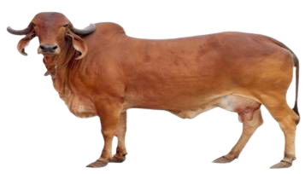
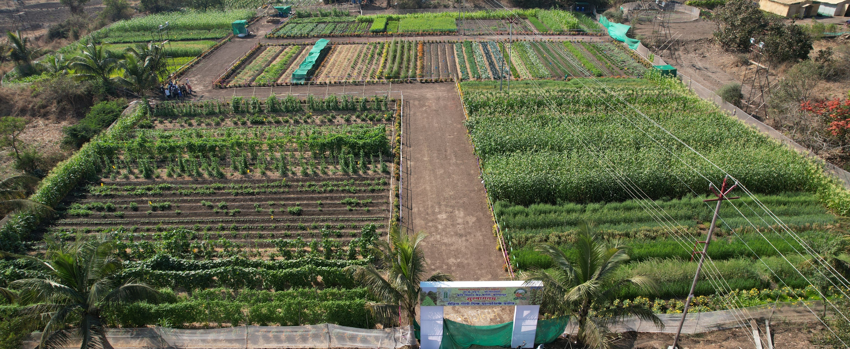
Thank You

