Slide 1
ICAR-Agricultural Technology Application Research Institute Zone-VIII, Pune
KVK LOGO
Annual Zonal Workshop of KVK’s
(Maharashtra, Gujarat and Goa)
Date
Annual Progress Report: Year
(January-December Year)
Presented by
Name
Senior Scientist & Head
KRISHI VIGYAN KENDRA, Name
Address:
Phone No.: -------------------- Email: ------------------------Website: ----------------------------

Slide 2
KVK Profile
Annual Zonal Workshop of Maharashtra, Gujarat and Goa Date
Number
TALUKAS
Agro-Climatic Zone
Demographic Information
Insert MAP of KVK Jurisdiction Area showing blocks and KVK Headquarters
Soil Type:
Taluka | Area (Km²) | No. of Villages
Total
Western Zone
Blocks
Soil: Laterite
Rainfall: heavy
Rainfall
Eastern Zone
Month | Rainfall (mm) | Rainy Days
Total | 1633.3 | 101
Blocks
Soil: Medium to deep black
Rainfall: Dry eastern zone with precarious rainfall
Central Zone
Blocks
Soil: Laterite
Rainfall: Assured rainfall

Slide 3
Annual Zonal Workshop of Maharashtra, Gujarat and Goa
Targets and Achievements of major activities: Jan-Dec Year
S. No. | Activity | Target |  | Achievements |  | Remarks if any
 |  | No. of programmes | No. of farmers | No. of programmes | No. of farmers
1 | OFTs |  |  |  |  | -
2 | FLDs |  |  |  |  | -
 | CFLD Pulses |  |  |  |  | -
 | CFLD Oilseeds |  |  |  |  | -
3 | Trainings |  |  |  |  | -
 | PF |  |  |  |  | -
 | RY |  |  |  |  | -
 | EF |  |  |  |  | -
 | Skill Trainings |  |  |  |  | -
 | Sponsored trainings |  |  |  |  | -
4 | Extension Activities |  |  |  |  | -
5 | Other if any | - | - | - | - | -

Slide 4
Annual Zonal Workshop of Maharashtra, Gujarat and Goa
Most significant achievements of KVK during: Year
Promotion of Natural Farming
Popularization of new variety
Established new Demos

Slide 5
Best OFT
Title:-
Problem Identified
Technologies assessed | T1: T2:
Year of assess
Source of Tech.
No. of trials
Critical inputs supplied
Farmers Feedback

Slide 6
Performance of Technologies Assessed
Introduction:-
Technology Assessed |  | No. of pod/ plant | No. of root nodules/ plant | Av. Yield (qt/ha) | Cost of Cultivation (Rs/ha) | Net return (Rs/ha) | B:C Ratio
T1
T2
Results/Conclusion:-

Slide 7
Annual Zonal Workshop of Maharashtra, Gujarat and Goa
Impact of major Interventions
Name of intervention/ Technology | No of beneficiary | % of Adoption | Change in income (Rs/annum)
 |  |  | Before | After

Slide 8
Annual Zonal Workshop of Maharashtra, Gujarat and Goa
Technology Recommended to State Department/University for adoption
Name of Technology | Recommended to | Mode of recommendation | Response from the concerned Department

Slide 9
Major Extension Activities Conducted during the year
Extension Activity | No. of programmes | No. of farmers | Extension person (No.) | Total
Advisory Services
Diagnostic Visits
Kisan Mela
Kisan Goshti
Guest Lectures
Celebration of important Days
Farmers visit to KVK
Exposure Visits
Farmers Club
Exhibition
Method Demonstrations
Scientist visits to farmers field
Seminar/ workshop
Grand Total

Slide 10
Other Extension Activities during the year
Extension Activity | Number
TV shows
Radio talks
News paper coverage
Extension literature
CD/Video
Popular articles
Success Stories
Social Media

Slide 11
Media Coverage

Slide 12
Annual Zonal Workshop of Maharashtra, Gujarat and Goa
Use of ICTs for Outreach by KVK in Jan-Dec Year
Name | No. of apps/ groups/ website address | No. of farmers/ likes/subscriptions/ views/ hits
WhatsApp |  | ----
You tube |  | ----- (Views)
Facebook |  | ---- (Followers)
Twitter |  | --- (Views)
KMAS |  | ----- (No of Farmers)
Website | Website address: | ----- (Hits)

Slide 13
Annual Zonal Workshop of Maharashtra, Gujarat and Goa
Production and supply of technology inputs from KVK
Name of the input | Variety / Breed / species, etc | Production | Supplied to No. of farmers | Value (Rs)
Seeds
Planting material
Bio-products
Livestock material
Value Addition
Performance of Demonstration Units at KVK
Name of the demonstration unit | Name of the product | Production during the year 2023 | Net profit realized (Rs)

Slide 14
Annual Zonal Workshop of Maharashtra, Gujarat and Goa
Details of collaborative activities conducted
Name of the sponsoring agency | Type of activity | Role of KVK | No. of farmers benefited | Financial support if any (Rs)
ATMA | Ranbhaji Mahotsav | Planning & Conducting Agency
Panchayat Samiti | Workshop on Organic Farming | Planning & Conducting Agency
Awards and Recognition
Awards (KVK/Farmers) | Name of the award | Given by | Nature of award | Given for

Slide 15
Annual Zonal Workshop of Maharashtra, Gujarat and Goa
Progress of other projects
Name of the Project | Implemented By | Brief Achievements (2-3 lines)
CFLD Oilseed | ICAR-ATARI, Pune
Agri-Drone Project | ICAR-ATARI, Pune
Outscaling of Natural Farming
Any Other (Mention name)

Slide 16
Annual Zonal Workshop of Maharashtra, Gujarat and Goa
Revolving Fund Status (Rs. In Lakh)
Financial Year | Opening Balance | Income | Expenditure | Closing Balance
2023-24
2022-23
2021-22
2020-21
2019-20
2018-19

Slide 17
Annual Zonal Workshop of Maharashtra, Gujarat and Goa 28 - 30th July, 2023
Scientific Advisory Committee (SAC) Status
Year | SAC Date | Reason for non conduct of SAC (if not conducted)
2024
2023
2022
2021
2020
2019

Slide 18
Annual Zonal Workshop of Maharashtra, Gujarat and Goa
Constraints and Infrastructure requirements of KVK
Fund required for the fencing of KVK farm.
Fund required for demonstration units:
Mushroom Cultivation Unit
Goatry Unit
Poultry Unit

Slide 19
Dignitaries visited to KVK

Slide 20
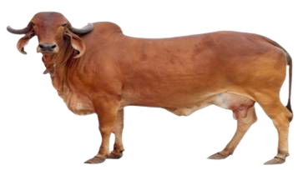
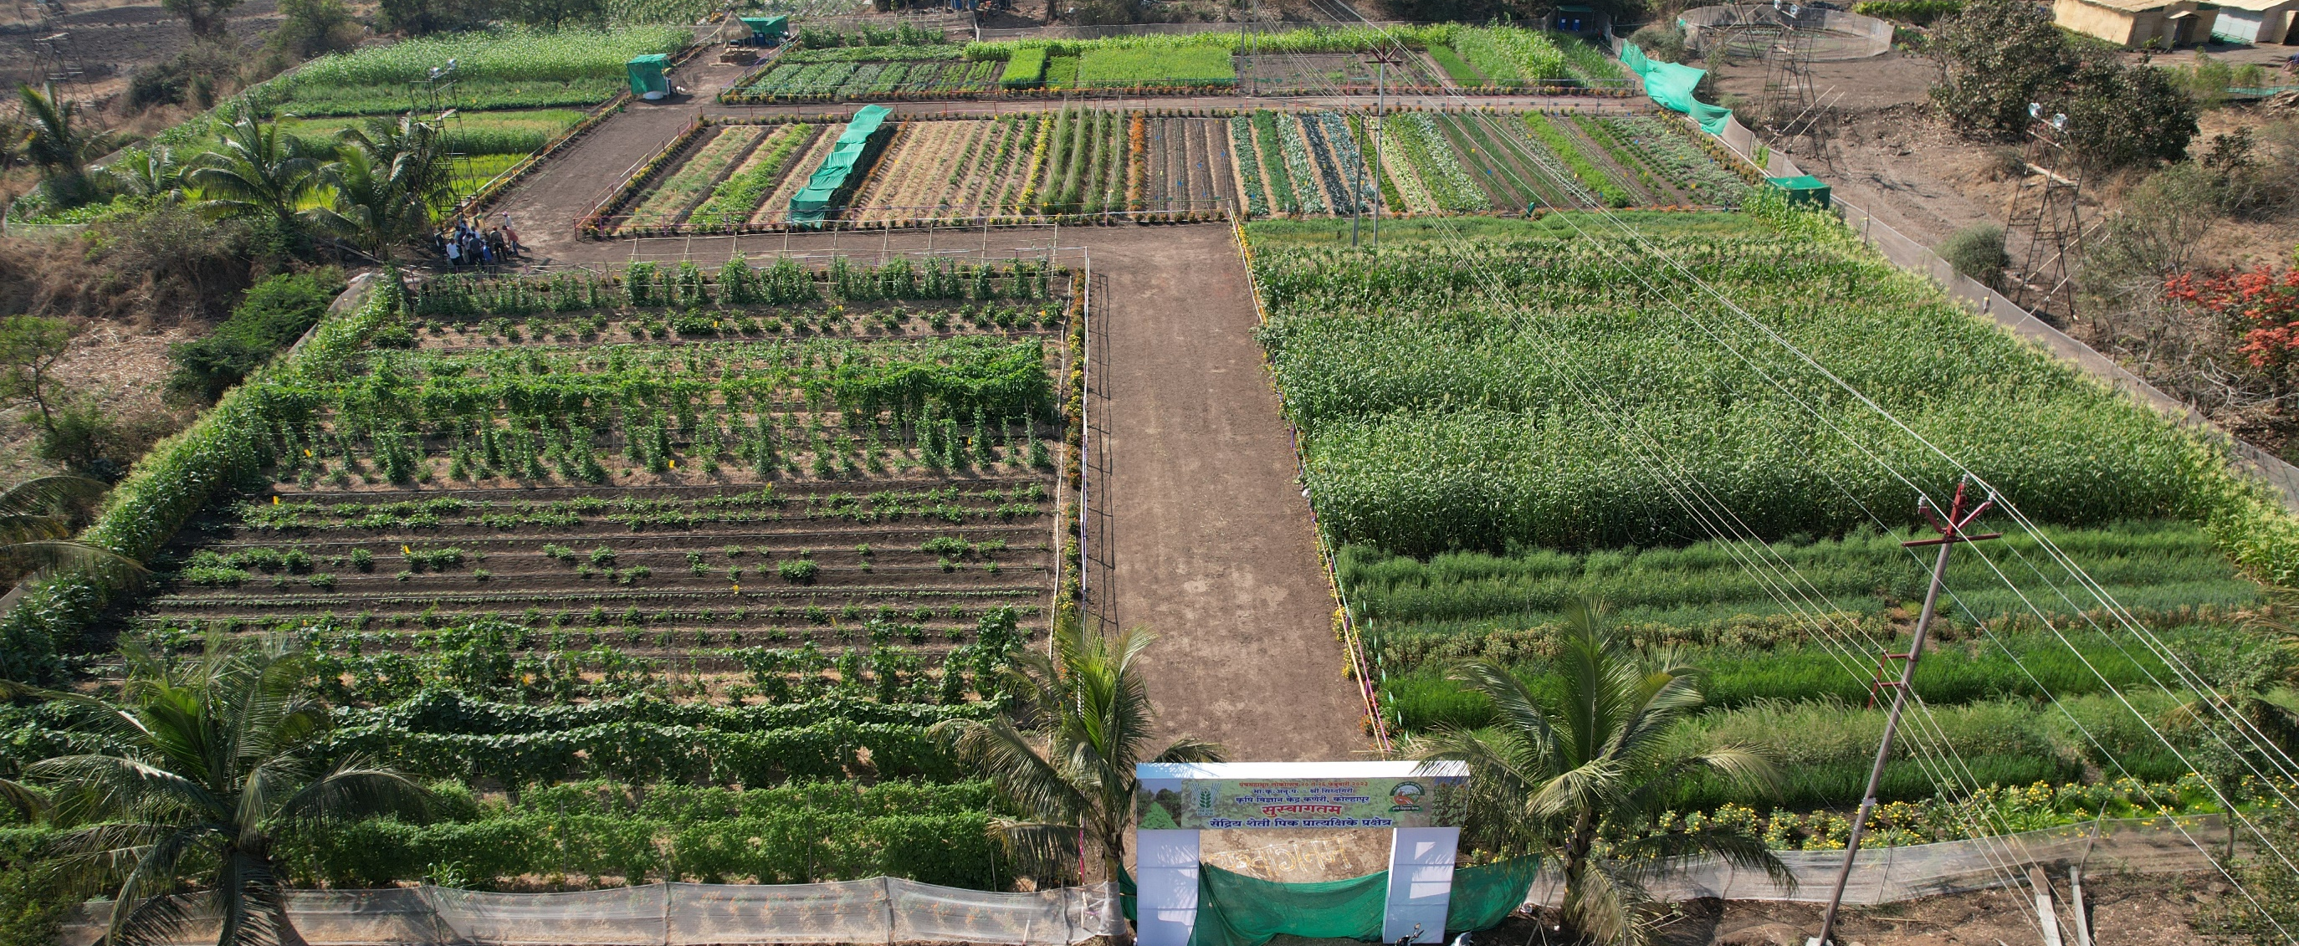
Annual Zonal Workshop of Maharashtra, Gujarat and Goa
Thank You

